Slide 1
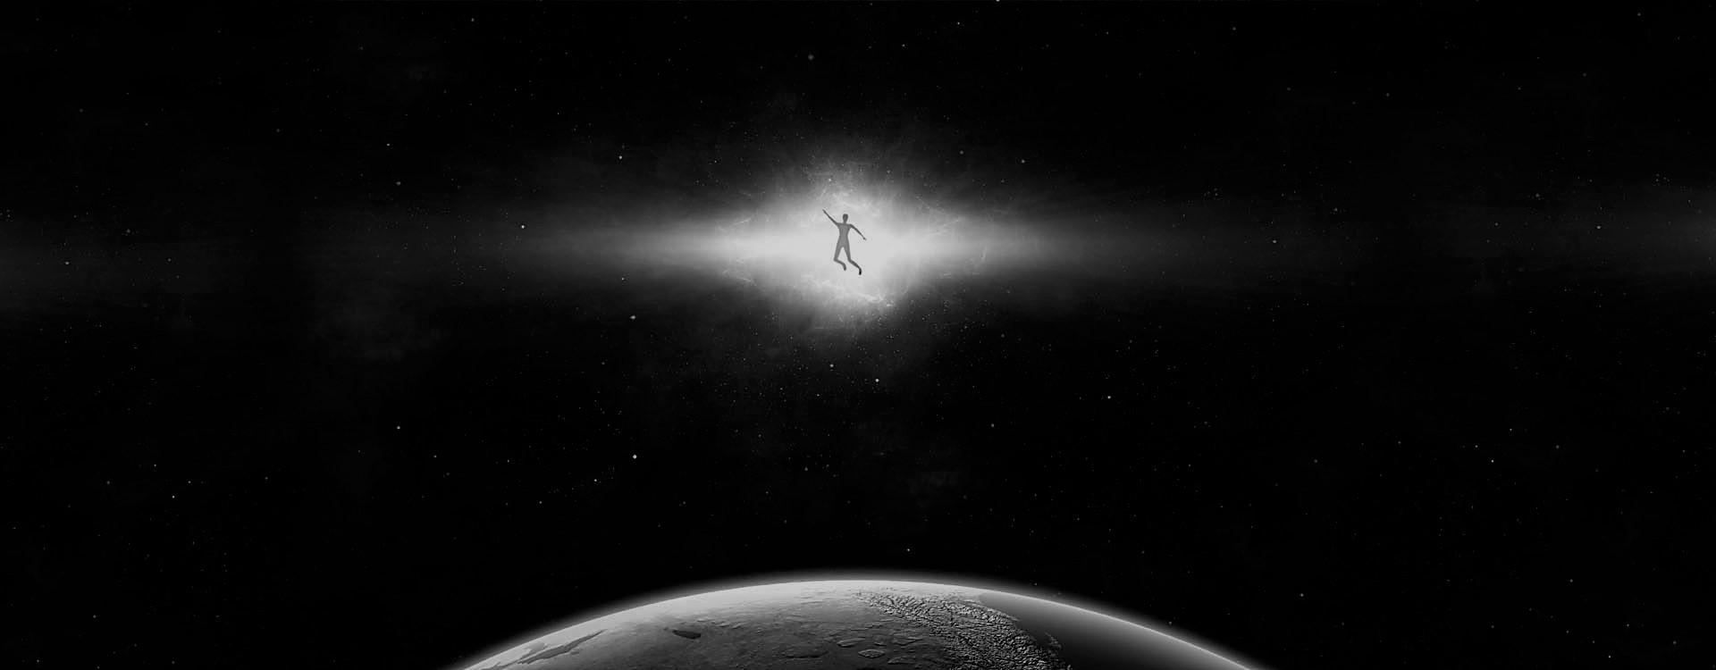
Measuring dark matter distribution around supermassive black hole with LISA
WHO
I WAS ?
Speaker: Rongzi ZHOU
The Chinese University of Hong Kong

Slide 2




Team
Supervisor
Tjonnie Li
PhD Student
Otto Hannuksela
MPhil Student
Kaye Li
Undergraduate Student
Rongzi Zhou

Slide 3
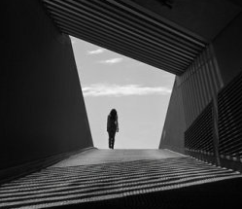
01
Why BH in GCs? Why GW?
02
Dark Matter admixed binaries with a certain density profile
CONTENTS
03
Model independent method

Slide 4
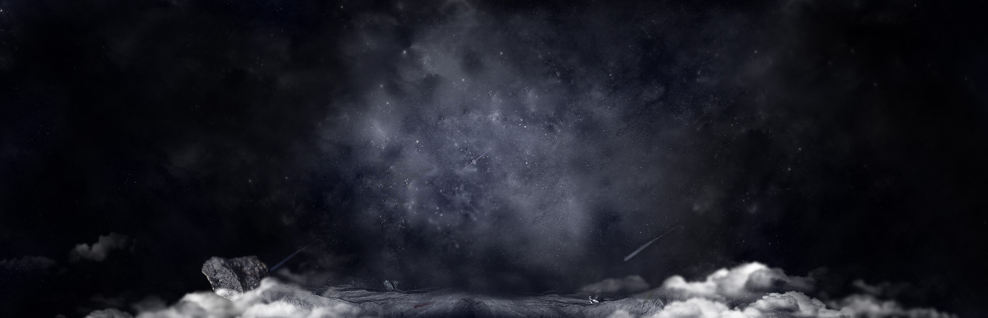
What are we interested in?
01
Methods to detecting dark matter

Slide 5
Challenge in detecting dark matter
Model Dependent
Model Independent
Annihilation signal
  Applies only to WIMP models
  Can be confused with pulsars
N-body simulations
  Highly model-dependent
Microlensing
  Only limited systems
  Density: ~1 GeV/cm^3
  Far from galaxy center
Galaxy Rotation Curves
  Density: ~1 GeV/cm^3
  Far from galaxy center
Notes:
Briefly explain why GW can be used to measure DM

Slide 6
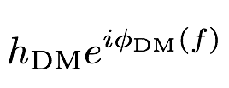
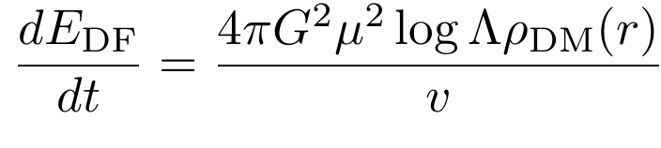
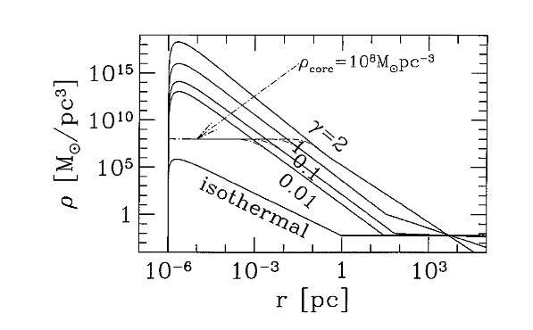
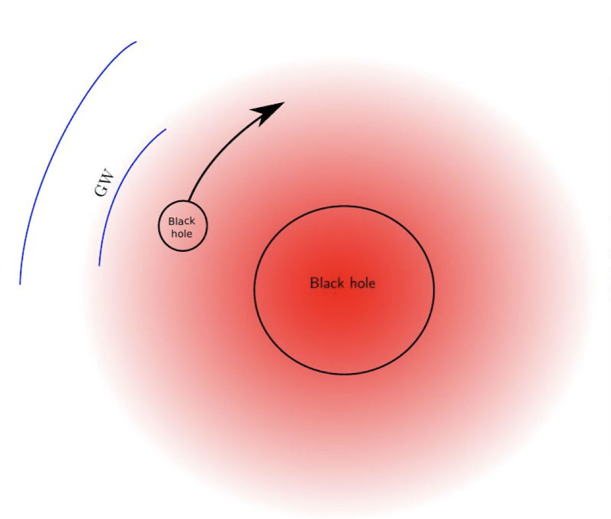
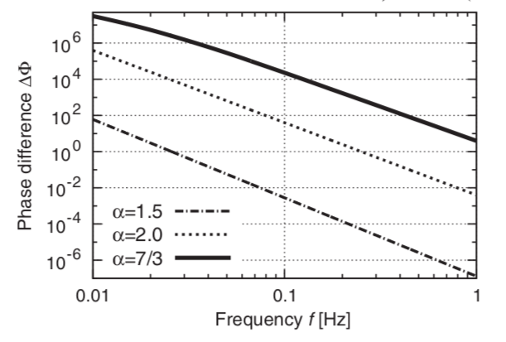
DM-spikes surrounding galactic black hole
(Paolo Gondolo, Joseph Silk 1999)
(Kazunari Eda, etc 2015)
Notes:
The system we investigate

Slide 7
What have we done?
02
Dark Matter Admixed Binaries Study

Slide 8
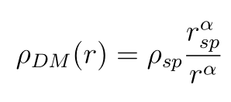
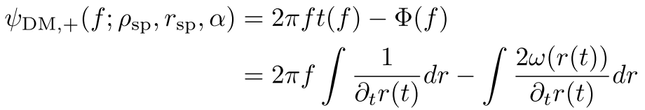
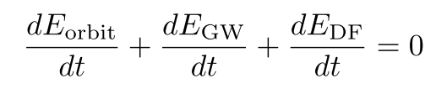
Dark Matter Effect on Binary Evolution
Stationary phase approximation
Notes:
1. Explain all the variables
2. How to derive the waveform ( mention Taylor expansion and delta < <1)
3. Perturbed model independent wave form mention later

Slide 9
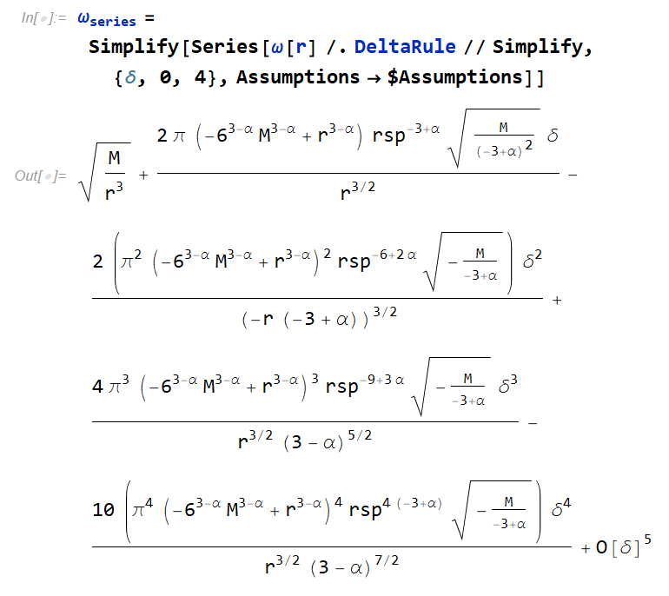
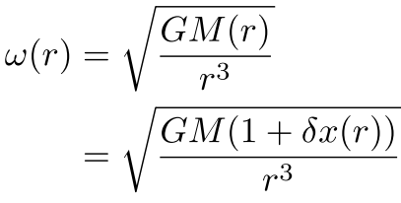
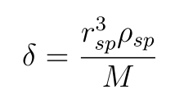

Slide 10
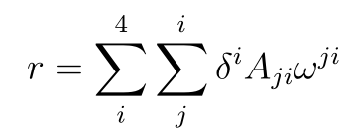
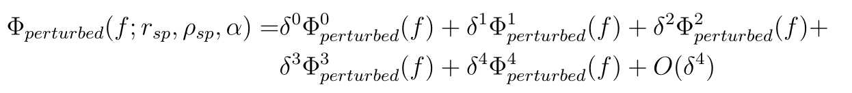

Slide 11
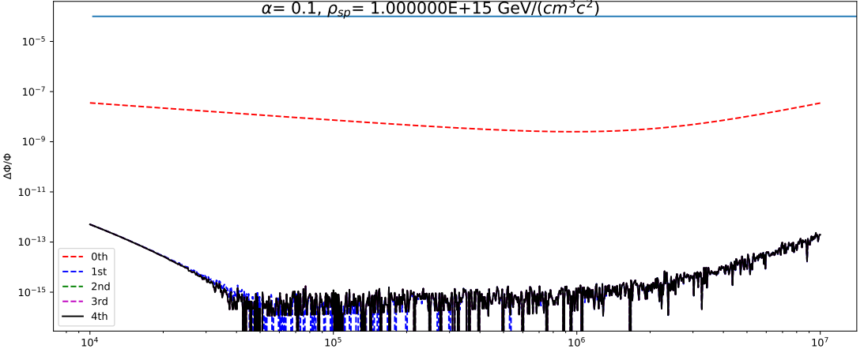
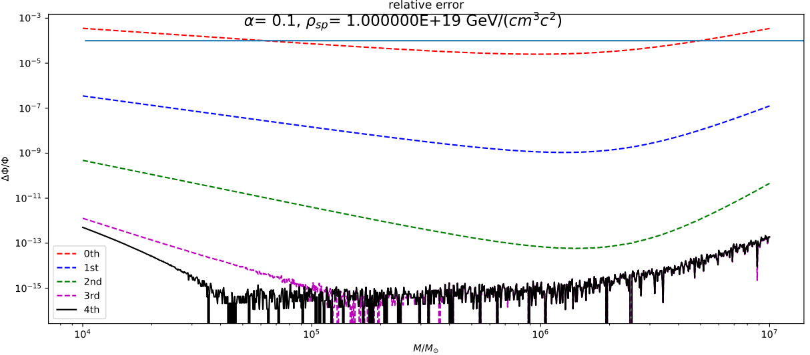
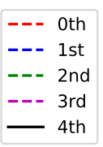
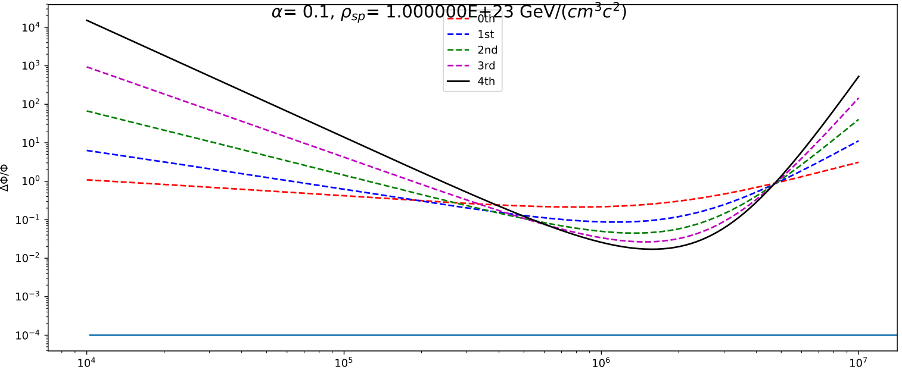
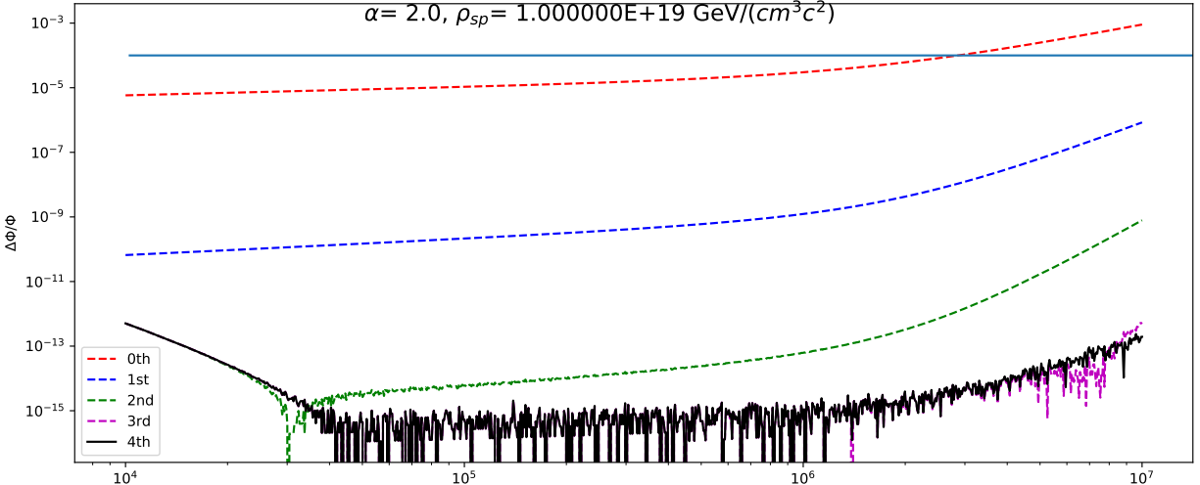
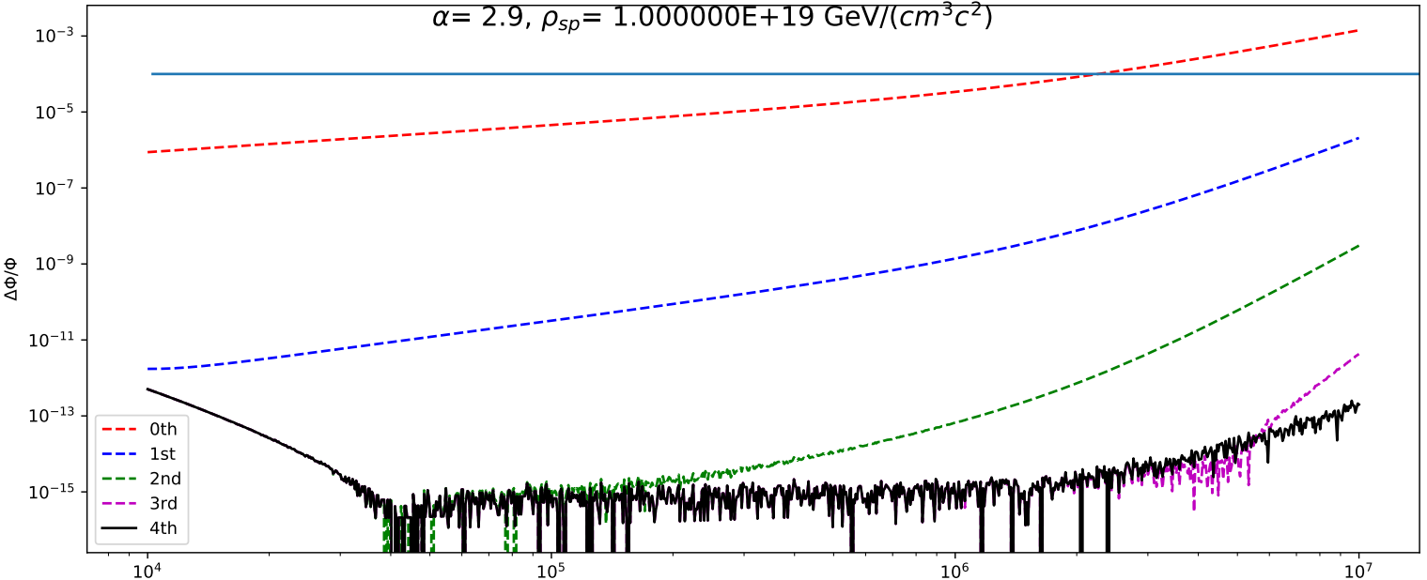
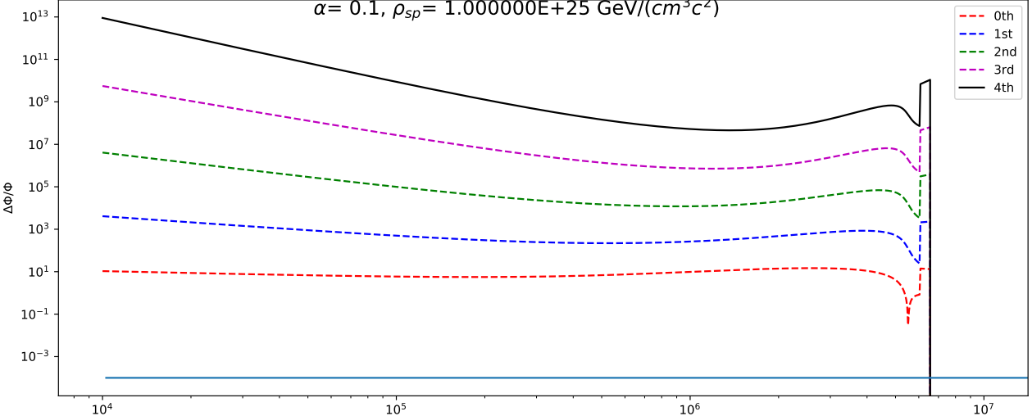






























Test some parameters
1
$${10}^{−3}$$
$$α=0.1, ρ_{sp}={10}^{15}GeV/cm^{3}$$
2
$${10}^{−3}$$
$${10}^{−7}$$
$$α=0.1, ρ_{sp}={10}^{19}GeV/cm^{3}$$
$${10}^{−7}$$
$${10}^{−11}$$
$${10}^{−11}$$
$${10}^{−15}$$
3
$${10}^{−15}$$
$${10}^{4}$$
5
$${10}^{2}$$
$$α=0.1, ρ_{sp}={10}^{23}GeV/cm^{3}$$
$$α=2.0, ρ_{sp}={10}^{19}GeV/cm^{3}$$
$${10}^{−1}$$
$${10}^{−3}$$
4
6
$${10}^{12}$$
$$α=0.1, ρ_{sp}={10}^{25}GeV/cm^{3}$$
$$α=2.9, ρ_{sp}={10}^{19}GeV/cm^{3}$$
$${10}^{7}$$
$${10}^{2}$$
$${10}^{−3}$$
$${10}^{4}$$
$${10}^{5}$$
$${10}^{6}$$
$${10}^{7}$$
$${10}^{4}$$
$${10}^{5}$$
$${10}^{6}$$
$${10}^{7}$$
Notes:
Vary alpha and rho to see when the model fails.

Slide 12
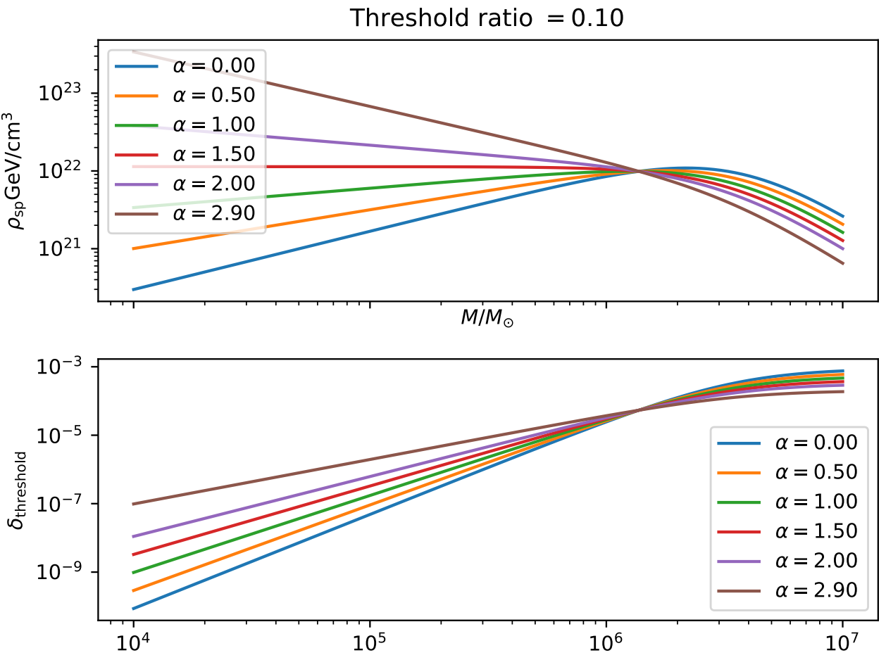
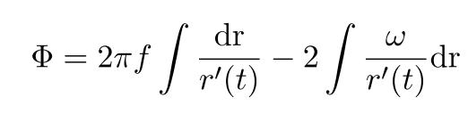
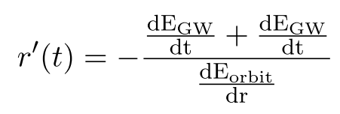
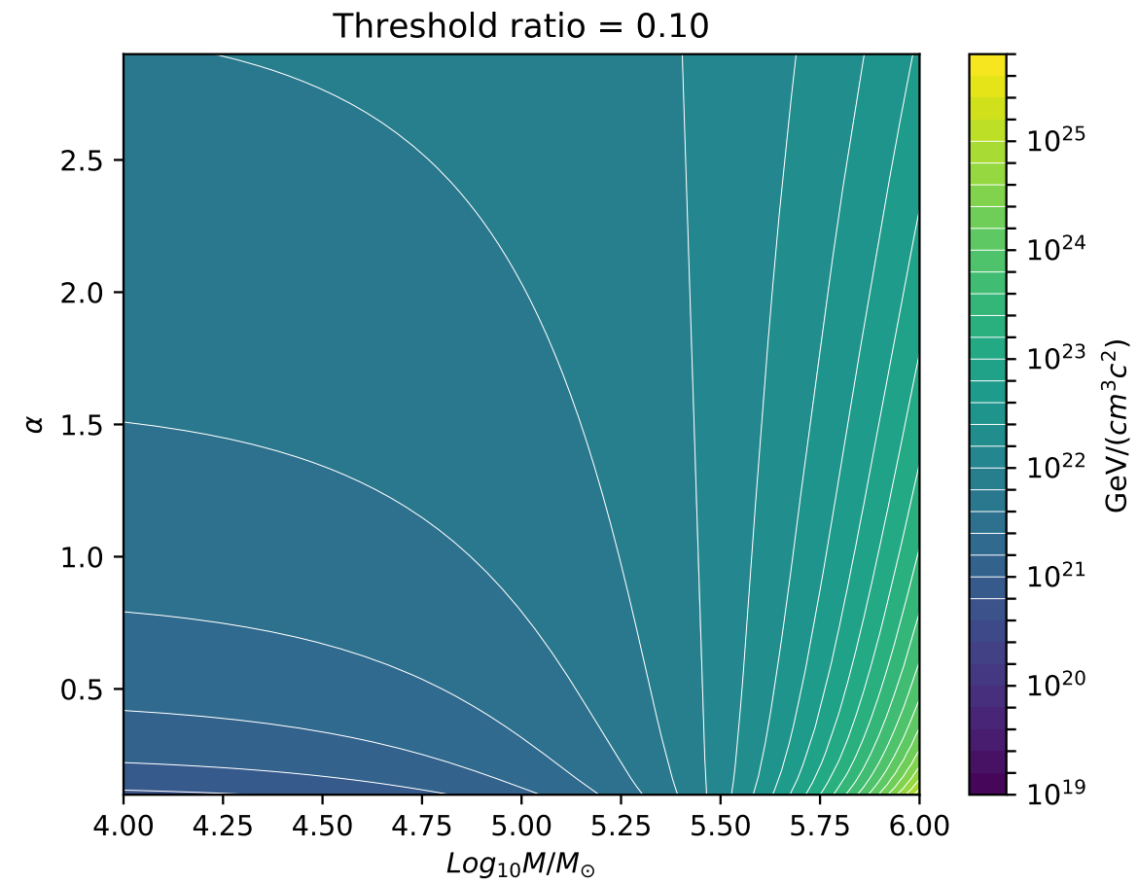
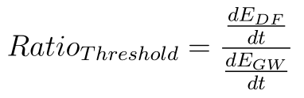
When can we trust it?
From Calculation:

Slide 13
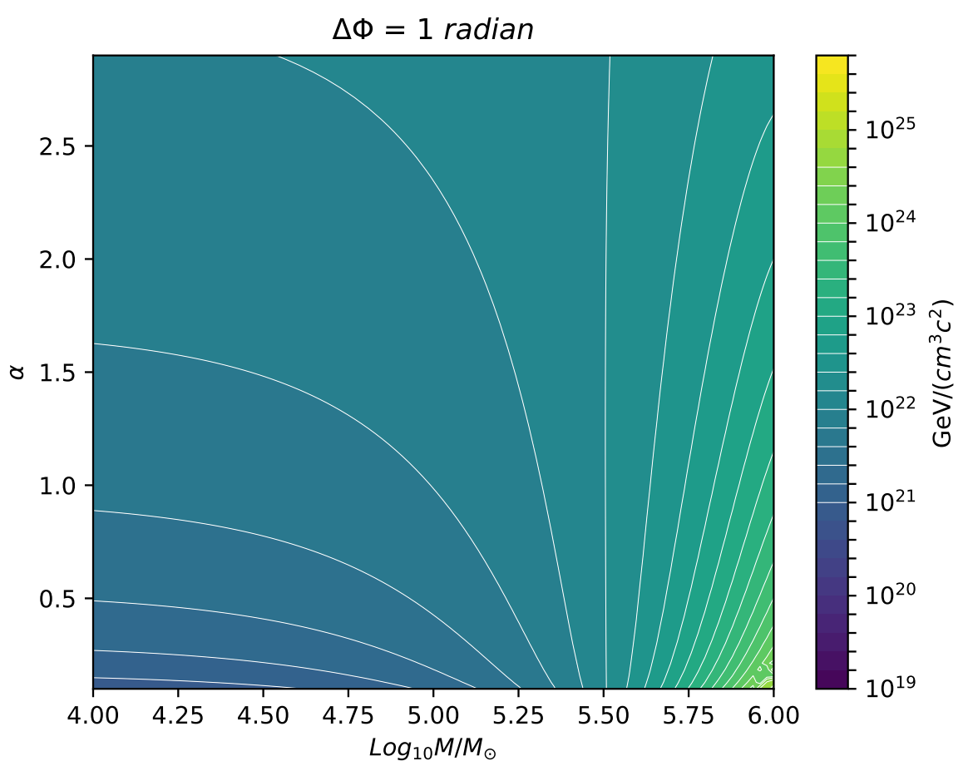
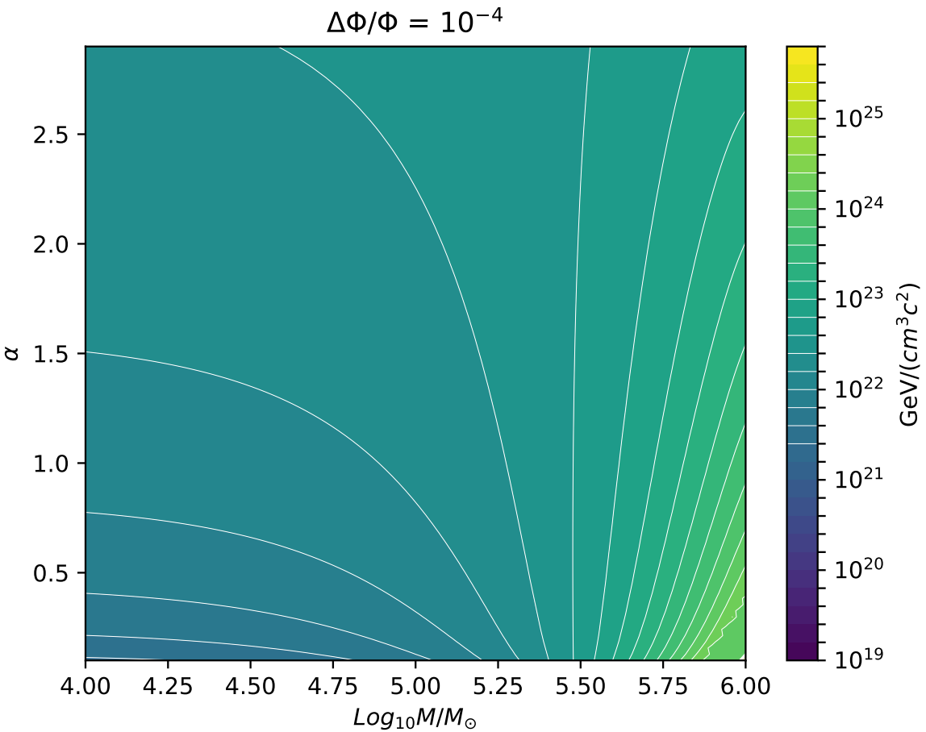
From Limits of LISA:

Slide 14
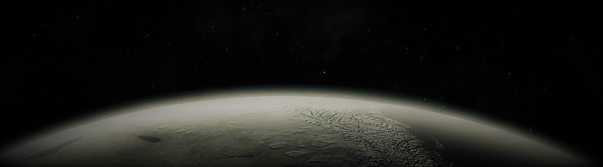
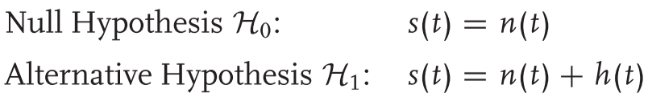
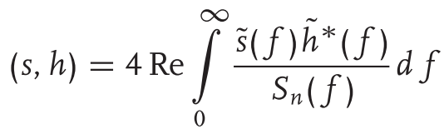

Gravitational-Wave Data Analysis
Matched Filter:
SNR:

Slide 15
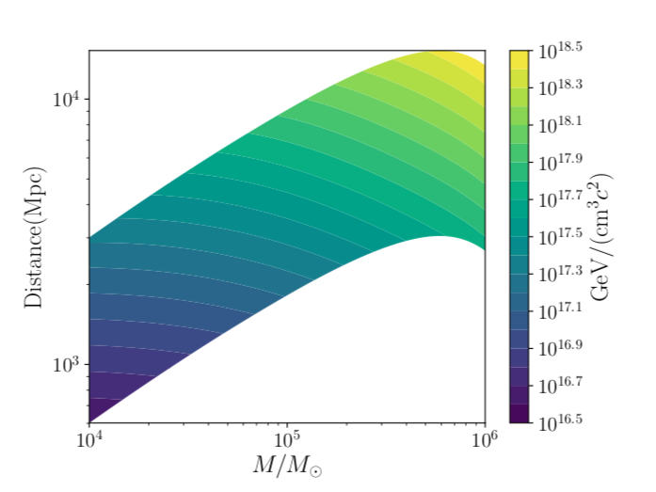

Detectability of DM for LISA
Detection Criteria (SNR)
(B Kocsis, N Yunes, etc 2011)
Minimum density of DM at 10M
Smaller mass ratio is favored in terms of DM sensitivity(can detect even in low ratio)
Million solar mass SMBH is favored in terms of event rate(assume evenly distributed)
Can be detected!

Slide 16
Now we consider cosmological redshift
Lower Index 0 means Chirp mass and frequency seen by the LISA detector
(the ones without lower indices are source parameters)
Redshifted Frequency
Redshifted Chirp Mass
Notes:
# h(f) \sim \frac{1}{r} \frac{{\mathcal{M}}^{5/6}}{f^{7/6}} e^{- i \Phi(f)}

Slide 17
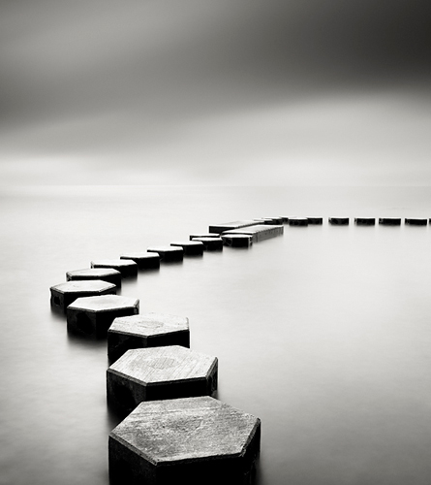
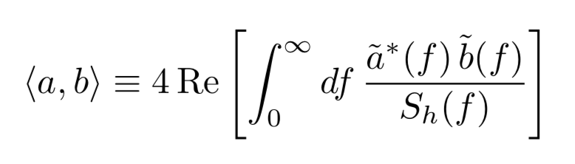
Model-independent method
What is ongoing?
Perturb the energy balance equation
02
Template Bank for LISA
Matched Filtering

Slide 18

That’s our journey casing for the whisper from our universe
Thank you!

